Slide 1
University American College Skopje
Course: Business Computer Applications
Industry 4.0 digital transformation – part II
Marija Stanojeska, PhD

Slide 2
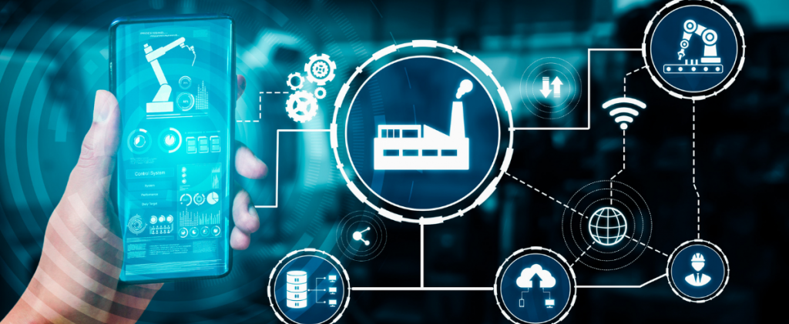
Based on the textbooks:
Industry 4.0: Managing The Digital Transformation, Ustundag A., Cevikcan E.
Industry 4.0: The Industrial Internet of Things, Gilchrist A.

Slide 3

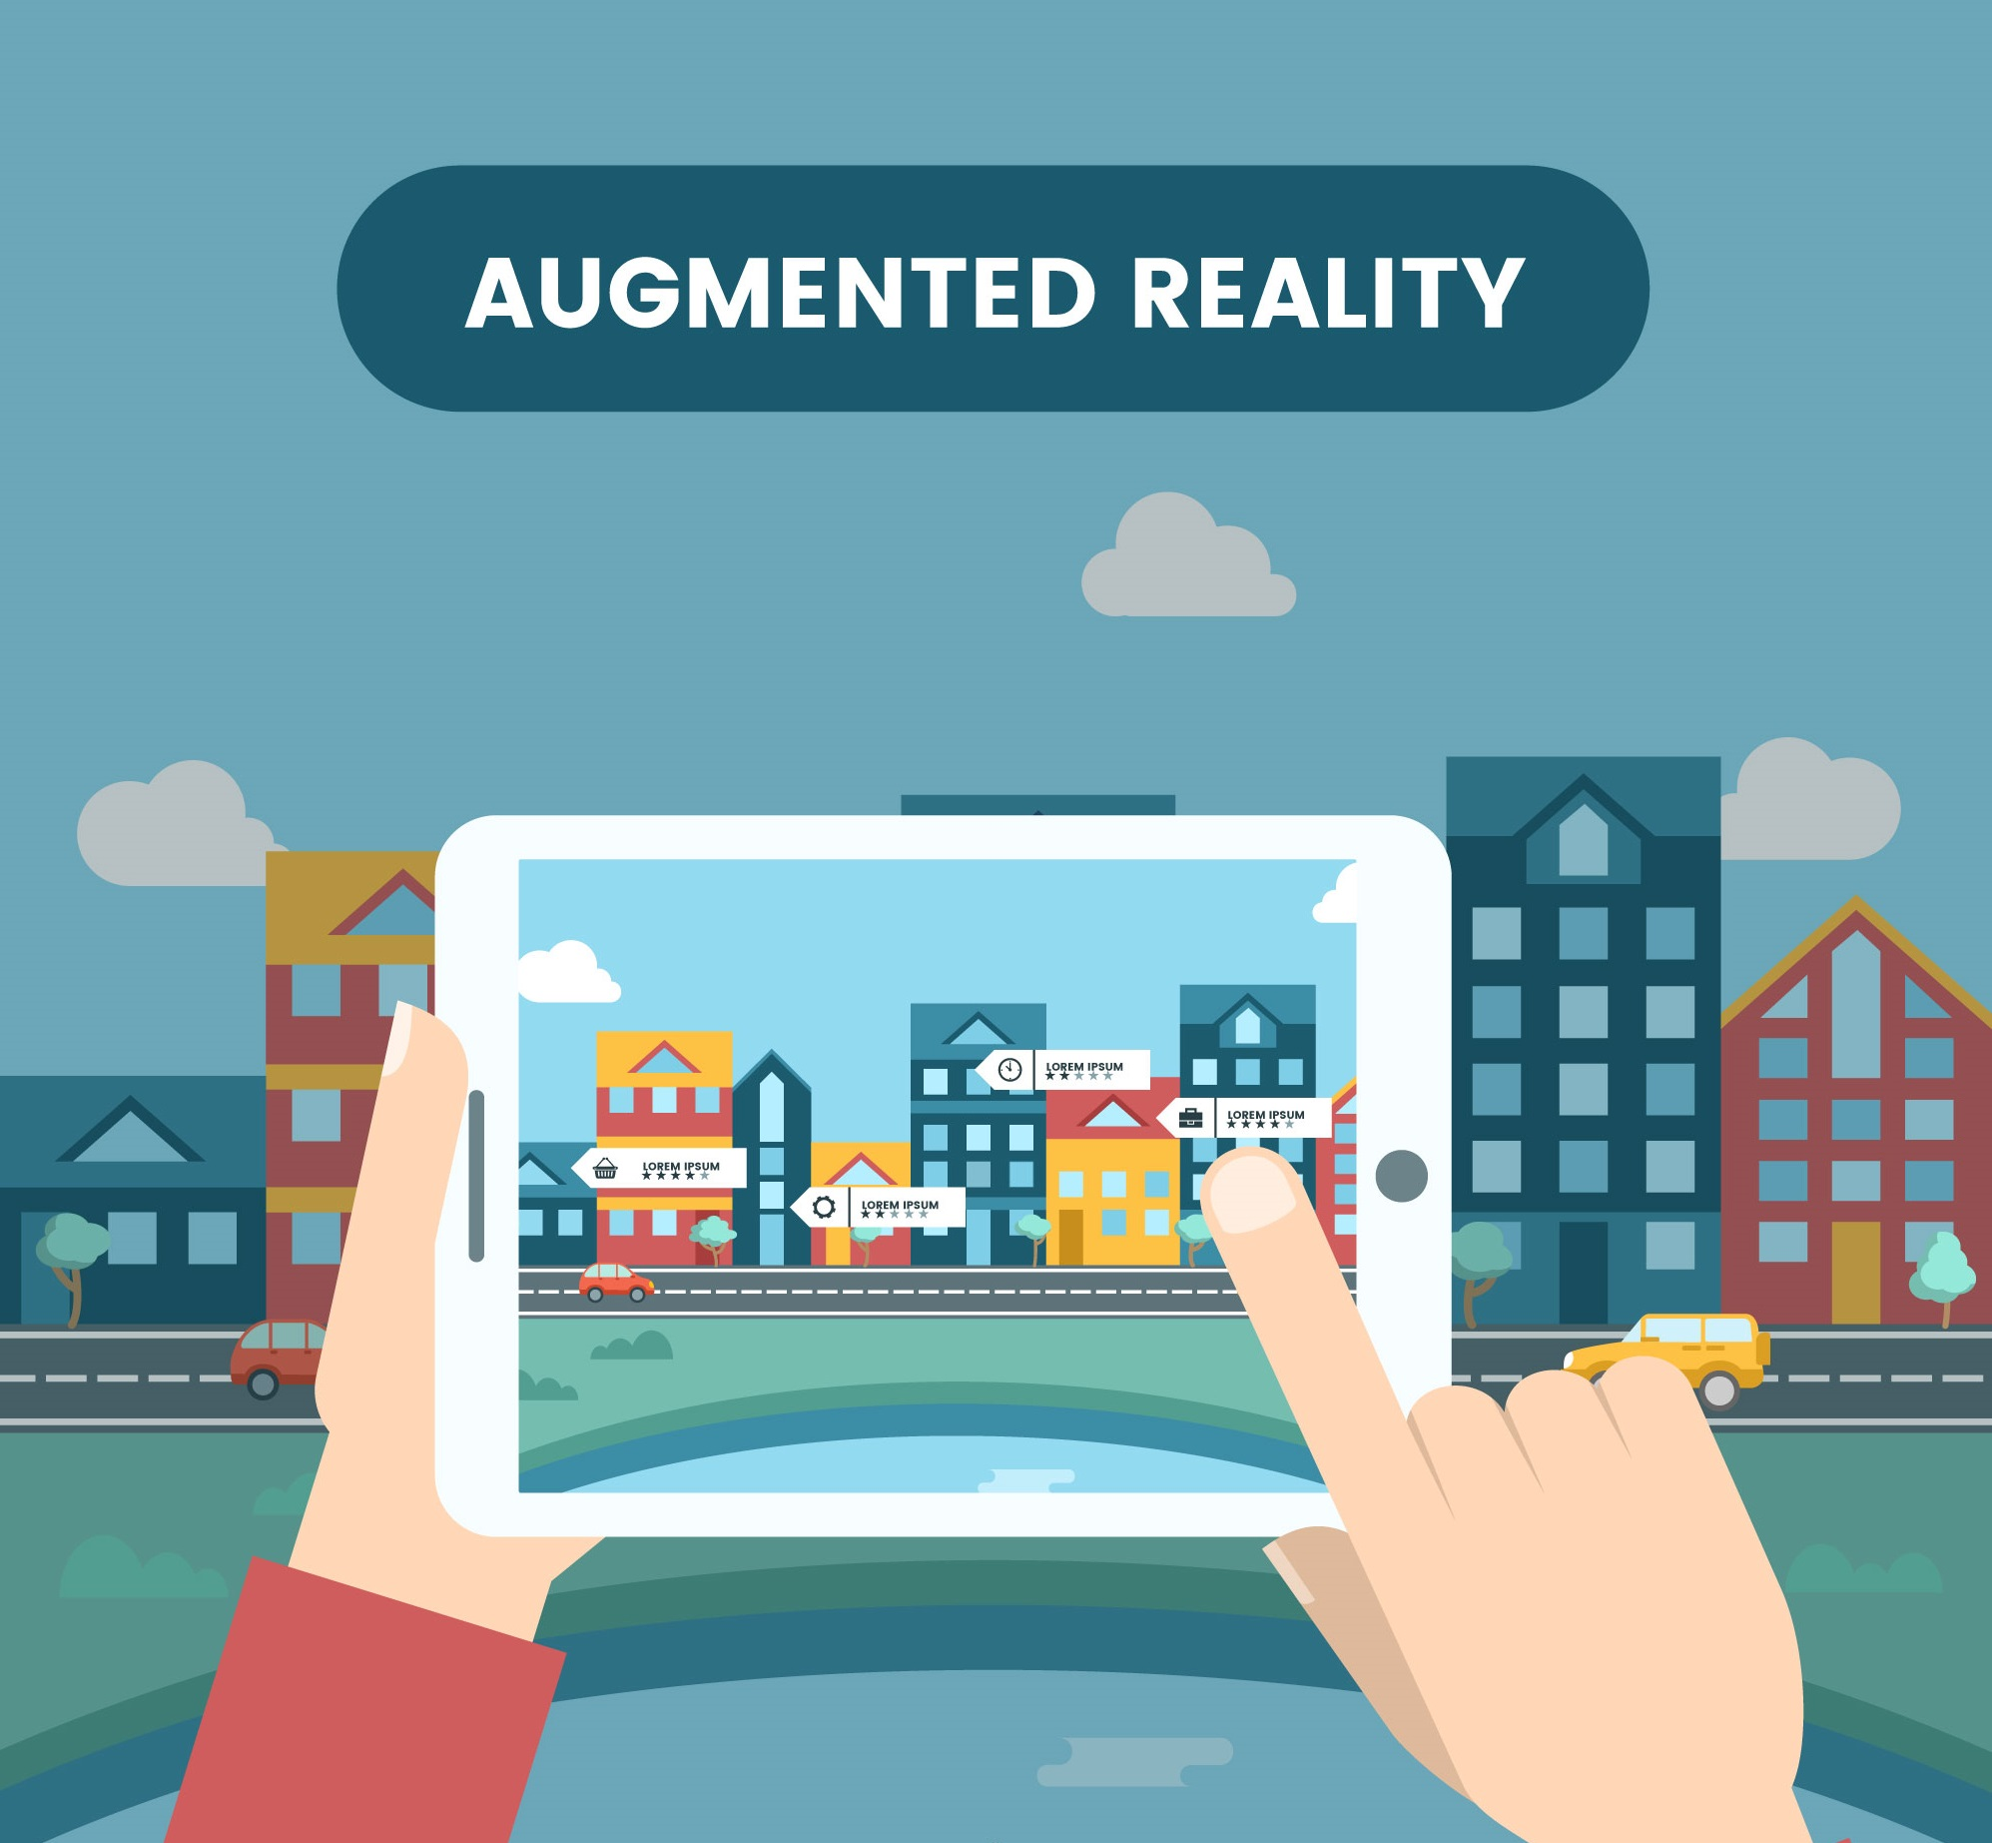
Augmented Reality - AR
Augmented Reality (AR) is the technology that expands our physical world by adding layers of digital information onto it. AR appears in direct view of an existing environment and adds sounds, videos, graphics to it.
A wide application in different disciplines of this technology is notable.
  Education & Science;
  Navigation & the Travel Industry;
  Retail & E-commerce;
  Medicine;
  Creative Industry;
  Architecture;
  ……
Benefits of Augmented Reality for business marketing
  Created a rich and immersive experience;
  Growing industry;
  Bring the store to the customer;
  Going viral;
  Reduce language barriers;
  Stand out from the rest;
  Generate analytics.

Slide 4
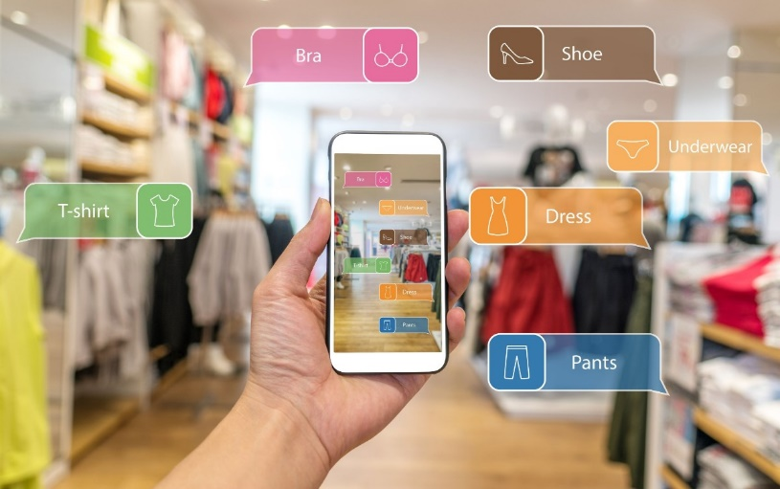
Looking deeper into AR
Augmented reality is an interactive experience in which a real world environment is enhanced with computer-generated visual elements, sounds, and other stimuli. It can provide a user with a heightened, more immersive experience than they would experience otherwise that adds to the user's enjoyment or understanding. From a commercial perspective, augmented reality can increase brand awareness and boost sales.
Since augmented reality uses a real world environment in conjunction with computer-generated visual elements, it may be seen as more realistic than virtual reality, which is 100% computer-generated. However, advances in technology mean that even entirely virtual environments can seem fully realistic.
The metaverse is a shared virtual environment with aspects of online gaming, augmented reality, and more that people can access via the Internet.

Slide 5
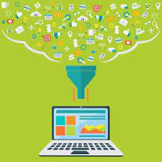
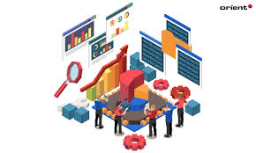
Big Data
Big data is an evolving term that describes any voluminous amount of structured, semi structured and unstructured data that has the potential to be mined for information. It is used for:
Understanding and targeting customers.
Understanding and optimizing business processes.
Personal quantification and performance optimization.
Improving healthcare and public health.
Improving sports performance.
Improving science and research.
Optimizing machine and device performance.
Improving security and law enforcement.
Improving and optimizing cities and countries.
Financial trading.
Benefits of Big Data for business
Better dialogue with consumers.
Opportunity for product re-development.
Efficient risk analysis.
High level of data safety.
New revenue streams.
Real time website customization.
Acquiring enterprise-wise insights.
Making cities smarter.

Slide 6
Looking deeper into Big Data
Big data exactly can be defined as data sets whose size or type is beyond the ability of traditional relation databases to capture, manage and process the data with low latency. Characteristics of big data include high volume, high velocity and high variety. Sources of data are becoming more complex than those for traditional data because they are being driven by artificial intelligence (AI), mobile devices, social media and the Internet of Things (IoT). For example, the different types of data originate from sensors, devices, video/audio, networks, log files, transactional applications, web and social media - much of it generated in real time and at a very large scale.
Big data is a great quantity of diverse information that arrives in increasing volumes and with ever-higher velocity.
Big data can be structured (often numeric, easily formatted and stored) or unstructured (more free-form, less quantifiable).
Nearly every department in a company can utilize findings from big data analysis, but handling its clutter and noise can pose problems.
Big data can be collected from publicly shared comments on social networks and websites, voluntarily gathered from personal electronics and apps, through questionnaires, product purchases, and electronic check-ins.
Big data is most often stored in computer databases and is analyzed using software specifically designed to handle large, complex data sets.

Slide 7
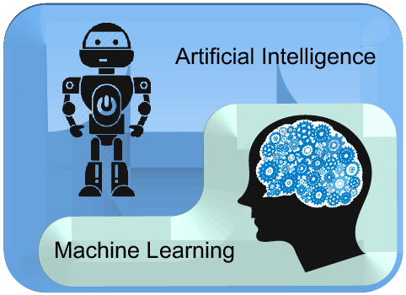
Artificial Intelligence and Machine Learning
The amount of data generated by IoT- based networks makes it virtually impossible for humans to analyze and contextualize them. This is where artificial intelligence and machine learning become indispensable in making the gathered data valuable.
Artificial intelligence (AI) is the simulation of human intelligence processes by machines.
This includes learning (the acquisition of information and rules for using the information), reasoning (using the rules to reach approximate or definite conclusions) and self-correction.
Machine learning (ML) is a way to make AI possible.
AI and ML based mechanisms can spot anomalies, make predictions, and provide recommendations for the operation and maintenance of the system.
Top uses for AI and ML:
  Research;
  Office automation;
  Consumer behavior analysis;
  Security monitoring;
  Fraud detection;
  Market projection/sales forecasting.

Slide 8
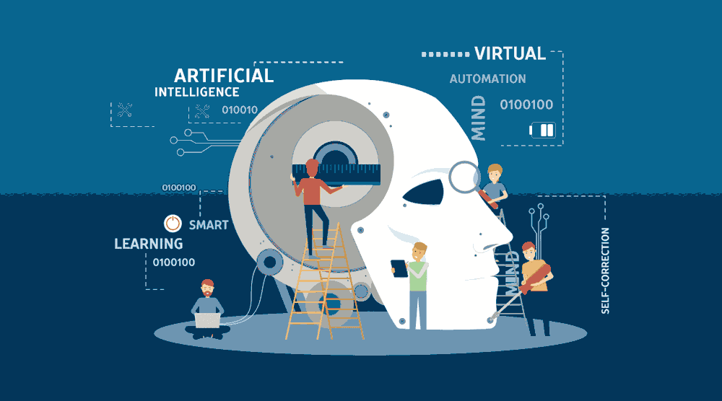
Looking deeper into AI and ML
Artificial intelligence is a technology using which we can create intelligent systems that can simulate human intelligence. Artificial intelligence is a field of computer science which makes a computer system that can mimic human intelligence. AI means "a human-made thinking power.“
The Artificial intelligence system does not require to be pre-programmed, instead of that, they use such algorithms which can work with their own intelligence. It involves machine learning algorithms such as Reinforcement learning algorithm and deep learning neural networks. AI is being used in multiple places such as Siri, AI in Chess playing, etc.
Machine learning is about extracting knowledge from the data. It can be defined as, Machine learning is a subfield of artificial intelligence, which enables machines to learn from past data or experiences without being explicitly programmed.
Machine learning enables a computer system to make predictions or take some decisions using historical data without being explicitly programmed. Machine learning uses a massive amount of structured and semi-structured data so that a machine learning model can generate accurate result or give predictions based on that data.
Machine learning works on algorithm which learn by its own using historical data. It works only for specific domains such as if we are creating a machine learning model to detect pictures of dogs, it will only give result for dog images, but if we provide a new data like cat image then it will become unresponsive. Machine learning is being used in various places such as for online recommender system, for Google search algorithms, Email spam filter, Facebook Auto friend tagging suggestion, etc.

Slide 9
Machine Learning vs. Artificial Intelligence vs. Data Science
Data Science
Collection, preparation, and analysis of data.
Leverages AI/ML, research, industry expertise, and statistics to make business decision.
Data Science
Artificial Intelligence
Technology for machines to understand/interpret, learn, and make “intelligent decisions”.
Includes ML among many other fields.
Artificial Intelligence
Machine Learning
Algorithms that help machines improve through supervised.
Unsupervised, and reinforcement learning.
Subset of AI and Data Science tool.
Machine Learning
Read more at: https://braincube.com/resource/manufacturing-ai-vs-machine-learning-vs-data-science/

Slide 10
Additional digital technologies within the context of Industry 4.0
Cyber-physical systems
Broadly speaking, cyber-physical systems (CPS) are machines controlled by computers and algorithms. These devices are monitored by computers, who are in control of the physical processes involved. However, the real key to this technology resides in its feedback, which is used by the system to interpret actions, track results, and automatically learn to improve efficiency.
Although these systems may seem somewhat complex, it’s easier to understand them through some examples. Self-driving cars, home automation systems, or civil infrastructure and road monitoring systems are all manifestations of this technology.
Digital twin
A digital twin is a given machine or component’s virtual recreation that enables simulating its operation. Consequently, it enables studying how a real machine will behave under certain given circumstances and also performing predictive maintenance since it’s a tool that can be used for anticipating a machine’s possible future breakdowns.
Cobots
Cobots are robots that collaborate among themselves or with human operators and they have become a trend in the manufacturing industry. It’s being anticipated that their use in factories will increase to ease the tasks of their human co-workers by taking on repetitive duties or the most hazardous ones to improve safety.
Blockchain
This technology might currently not be as well embedded in the manufacturing industry as it is in the financial industry but it harbors, nevertheless, a great many possibilities for Industry 4.0. It can guarantee the traceability of the entire production and supply chains, as well as other transactions.

Slide 11
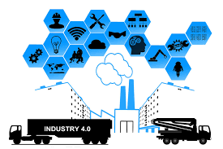
Benefits of Industry 4.0
More precise control over production lines.
Improve consistency of production.
Increase efficiency and revenue.
Predictive maintenance.
Less waste.
Enables higher growth levels.
Sustainable manufacturing.
Increase customer satisfaction.

Slide 12
Challenges of Industry 4.0
Once you’re ready to invest in Industry 4.0 technologies, you will be faced with several challenges and risks that need to be addressed.
Identifying goals. It’s crucial to identify the companies goals and the purpose for which Industry 4.0 will be used. If the system for an existing production plant is designed, it can be scaled up. In this case, the system should be designed in a way allowing for scalability.
Gathering high-quality data. Scalability is closely linked to the need to store large amounts of data and provide networks that can process a lot of data. Analyzing and providing the right information to the right machines or people at the right time is another challenge. This is not possible without high-quality data and algorithms, which are the foundation of any efficient and integral system in Industry 4.0.
Creating a fault recovery system. It’s also important for a company to design a fault recovery system. If there’s a mistake or inconsistency, we need to know what to do next and how the system can recover from it. This is just as crucial as ensuring system efficiency.
Cybersecurity. Another challenge is cybersecurity, as connectivity between manufacturing devices and IT resources can expose them to the same risks as traditional IT devices. In the past, factory systems were rarely connected to each other, so designing measures to protect the interconnected system is a new but crucial issue to consider.

Slide 13
Why is Industry 4.0 important for the future?
As we move forward in the digital age and face increasingly complex and unpredictable challenges, Industry 4.0 technologies are becoming more and more important for the future of business and industry.
Predicting the future
Industry 4.0 technologies are capable of spotting red flags and upcoming changes, thus preparing us better for whatever is coming. The COVID-19 pandemic has shown us that even the most exquisite planning and management systems can’t always help us predict the future.
Optimization and reduction of waste and pollution
Industry 4.0 also stands for optimization, meaning reducing production costs together with waste and pollution, as well. This is of particular importance nowadays, since natural resources are being depleted and the climate crisis is becoming impossible to ignore.
Healthier competition
Industry 4.0 reveals a new, desirable face of competition. By giving up on large-scale human involvement and the necessity to look for low-wage production sites in foreign countries, you may improve competition standards. Industry 4.0 is a natural consequence of the progress we’ve made so far and the digitalization of the world in general. It’s also an opportunity to make industry work more efficiently, fairly, and environmentally friendly.

Slide 14
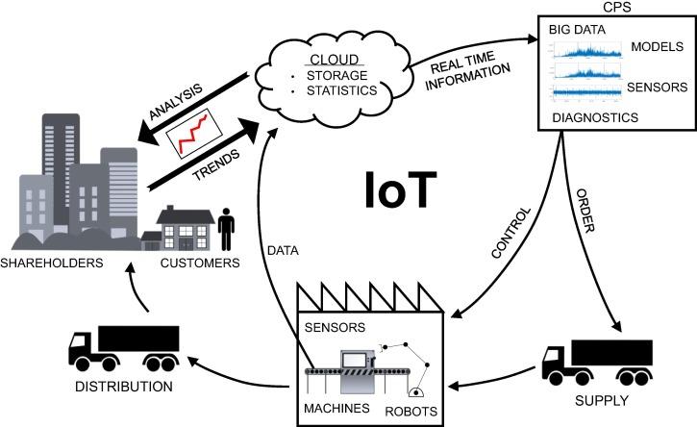
Introducing the Smart Factory
A smart factory is a highly automated manufacturing facility in industry 4.0 that utilizes advanced technologies, to optimize its operations and improve its efficiency, productivity, and quality. This may include the use of sensors, robotics, and automation to monitor and control production processes.
Smart Factories are not just intelligent machines and robots communicating through an advanced software product. Indeed, these machines have advanced beyond M2M and are not just collaborating but also communicating through advanced software, algorithms, and industrial processes.
However, it is important to realize that Smart Factories, like Smart Homes, are not some futuristic vision - they are with us today and have been for a decade at least.

Slide 15
Industry 3.0 vs. Industry 4.0 (example)
As an example, let’s take a production line that different lines of shampoo. In this production line scenario, a smart machine fills each bottle with the same base ingredients. To begin, consider how those different bottles of shampoo would have been produced on a traditional Industry 3.0 production line. This would have required three resources, one controller, and a supervisory system. At the lowest physical layer are the production resources, above them is the Manufacturing Execution System (MES), and one layer above that the Enterprise Resource Planning system (ERP).
Traditional Industry 3.0 production line

Slide 16
Traditional Industry 3.0 production line function
From the previous figure, we can see the three production resources required to make the shampoo products. The first resource R1 makes and stores the base ingredients. The second resource R2 receives a controlled amount of the base liquid, which it mixes with variant specific color additives, perfume, and chemicals/nutrients. Resource R3 receives the mixture from R2 and fills the appropriate bottle.
The ERP system controls production level by monitoring the sales orders generate by the reseller chains and supermarkets and sends instructions to the MES to manufacture the appropriate amounts to fulfill the orders. The MES initiates production to fulfill the orders and provides feedback of the production status to the ERP system.
Production works this way in a standard modern factory. However, it is not without its flaws and weaknesses.
The first weakness lies in the serial production line in so far as if one resource fails, then the whole production line fails.
Secondly, any failure in the ERP or MES will also block production. Expansion or reconfiguration of the production line is difficult due to the interfacing difficulties between the MES and resources, as there can be hundreds of interfacing options.
Thirdly, although it is highly desirable, it is not always feasible to have the ERP system updated in real time by the MES on the status of production (ex: the number of bottles produced and the number still to run to fulfill an order).

Slide 17
Industry 4.0 production line function
Industry 4.0 can mitigate some if not all of these weaknesses. The way Industry 4.0 works is that the resources in the previous example are replaced by CPSs (Cyber-physical system), as shown in Figure below.
Revised production line with CPS

Slide 18
Industry 4.0 production line function
The cyber-physical system - CPS have embedded sensors and can communicate with one another over wireless radio links, which enables one CPS to take over the tasks of a failed CPS. This ability for CPS to self-diagnose and check the status of the production line and then take appropriate collaborative action provides for improved availability and resilience. Additionally, because CPS interfaces with one another directly, they do not require a MES system so that removes another potential point of failure.
The self-sufficient CPS are not the only smart, intelligent entities on the production line, the product also is smart. For example, the shampoo bottles will be fitted with RFID tags, which identify which brand and type it is, and its own production history to date, as well as the next stage it has to proceed to in order to complete its production. Moreover, the product’s intelligence extends beyond the production line, even the smart factory, into the warehouse and later into the reseller chain.
Furthermore, the product’s intelligence stays active even in the service of the customer. For example, consider a far more intelligent product than the shampoo bottle, such as a tractor engine, the smart engine could during its productive working life self-diagnose and alert the customer or service department of its maintenance status and even predict failure of a component. This is an important shift from break-fix to fix-before-break and can greatly improve service availability and downtime.
With the MES becoming redundant to the smart design, the ERP system now becomes a smart ERP (SERP), and it communicates directly with the CPSs to control the production of products to fulfill the order books. By being directly connected, the SERP system now learns in real time the status of production, CPS health, and other real-time sensor data.

Slide 19

Exercise
Using the available internet sources, identify at least 3 world-class companies that practice the indicated digital technologies in their operations.
Additionally, list the companies’ benefits caused by the implemented technology.
Type | Augmented Reality | Big Data | Artificial Intelligence | Machine Learning
Company name
Benefits | ... … … … … | ... … … … … | ... … … … … | ... … … … …

Slide 20
Useful links
https://www.youtube.com/watch?v=Pl8OlkkwRpc
How the blockchain is changing money and business
https://www.youtube.com/watch?v=iVS-AuSjpOQ&t=4s
What is Digital Twin? How does it work?
https://www.youtube.com/watch?v=0KOUzeE0h8g
A cobot co-worker in manufacturing
https://www.youtube.com/watch?v=wro3uoHR-ZY
Cyber-physical Production Systems
https://www.youtube.com/watch?v=20RgRQhBVik
Augmented Reality in 2040: Top 9 Future Technologies
https://www.mckinsey.com/capabilities/mckinsey-digital/our-insights/rewired-for-value-digital-and-ai-transformations-that-work?stcr=173E7E034E684531923A72A36859313F&cid=other-eml-alt-mip-mck&hlkid=68dbbe2e1f1c4daca23eb48697193dce&hctky=14939448&hdpid=e50aceca-feb9-401d-a12c-8430b206cb75
Rewired for value: Digital and AI transformations that work

Slide 21
Thank you for your attention!

